Slide 1
How to Understand an Article
An Introduction to Interpreting Clinical Papers
Library service, University Hospitals Bristol

Slide 2
What is Critical Appraisal?
Critical appraisal is an assessment of the strengths and weaknesses of research methodology. It aims to examine bias and assess both internal validity and external validity
Bias
Systematic error in individual studies that can lead to erroneous conclusions (e.g. an overestimation or underestimation of the true result).
Internal validity
The extent to which the design and conduct of a study are likely to have prevented bias, and therefore, the results may be considered reliable. It is concerned with intrinsic factors.
External validity
The extent to which the results of a study might be expected to occur in other participants/settings (generalisability). It is concerned with extrinsic factors.
Critical appraisal is a holistic process which involves an examination of both the methods and the results.
Critical appraisal is:
A balanced assessment of the benefits/strengths and flaws/weaknesses of a study
An assessment of research process and results
Consideration of quantitative and qualitative aspects
Critical appraisal is not:
Negative dismissal of any piece of research
Assessment on results alone
Based entirely on statistical analysis
Undertaken by experts only
Values of Critical Appraisal
More emphasis on intrinsic factors than extrinsic factors
Evaluates evidence – not accepting at face value, confidence to accept/reject
Structured agenda
Explicit judgments
Challenges assumption
Application to own research
What do you need to know?
Bias in study designs
Tools and resources for appraisal
Statistics!

Slide 3
Select the research design
Randomised Control Trial | Systematic Review | Cohort Study | Case Control Study
Case Series | Case Report | Cross-Sectional Study | Qualitative
New mothers who don’t breast-feed are asked their views on breast-feeding
Children with a fever are given either paracetamol or ibuprofen to determine which is better at reducing the fever
50 young women with viral hepatitis and 50 young women without viral hepatitis were queried about recent ear-piercing to determine if ear piercing is a risk factor for viral hepatitis.
All the evidence on the effectiveness of clinical librarian services in supporting patient care is located, appraised and synthesised
An incidence of deficiency-related rickets in a set of twins aged 10 months is reported in an article
A large-scale population based questionnaire study examining the prevalence of stroke risk factors. Participants were surveyed once.
550 people who smoke cannabis are monitored over 15 years to determine whether they are at a higher risk of developing schizophrenia than people who do not smoke cannabis
An article describes the symptoms and clinical profile of 5 children who presented to an Emergency Department who were suspected to have abdominal epilepsy
Exercise Pg 4 Workbook

Slide 4
Levels of Evidence
Case-Control Study
Case Report / Case Series
RCT without blinding
Cross-sectional Survey
Non-Randomised Controlled Trial
Systematic Review with MA
Expert Opinion
Double-blind RCT
Cohort Study
Systematic Review

Slide 5
Levels of Evidence
Systematic Review
Cohort Study
Case-Control Study
Systematic Review with MA
Expert Opinion
Case Report / Case Series
RCT without blinding
Double-blind RCT
Cross-sectional Survey
Non-Randomised Controlled Trial

Slide 6
QUICK QUIZ
What is bias?
A Favouritism shown by a course leader
B Something used to bind the hem of a skirt
C Factors affecting the results of a study

Slide 7
Types of Bias
Detection bias
Selection bias
Confounding
Integrity of Intervention
Performance bias
Power calculation
Attrition
Allocation bias
Reliability of outcome tool
Validity of outcome tool

Slide 8
Types of Bias
Power Calculation: The ability of a study to detect the smallest clinically significant difference between groups when such a difference exists. The probability of detecting a chance finding decreases with an increasing sample size. A lack of a clinically significant effect could be due to insufficient numbers rather than the intervention being ineffective.
Selection bias: A systematic error in choosing subjects for a study that results in an uneven comparison. Selection bias may refer to the how the sample for the study was chosen (external validity) or systematic differences between the comparison groups that is associated with outcome (interval validity) of a study.
Randomisation: All participants should have an equal chance of being assigned to any of the groups in the trial. The only difference between the 2 groups should be the intervention. Any differences in outcome can then most likely be contributed to the interventions and no other variable (e.g. patient characteristics).

Slide 9
Randomisation
True or false: Randomisation is important when testing an intervention is effective because:
Every patient has an equal chance of entering either arm………………….
It guarantees that the intervention group and control group are comparable…………………………………
Allocation to either arm is concealed…………………………………..

Slide 10
Types of Bias
Ascertainment Bias (Blinding): Random concealment up to the point of assignment is used to minimise selection bias. By contrast, blinding after a patient has been assigned serves primarily to reduce performance bias (in patients and carers)
Attrition: The loss or exclusion of participants during a trial is known as attrition. The result of such attrition is that the investigators are left with incomplete outcome data; their sample is reduced.
Confounding: A confounder is a factor that is: Linked to the outcome of interest, independent of the exposure. Linked to the exposure but not the consequence of the exposure.

Slide 11
Confounding
What is the confounding factor in the following relationships:
People who carry matches are more likely to develop lung cancer
People who eat ice-cream are more likely to drown
Training in anaesthesia is more likely to make doctors commit suicide

Slide 12
Other Considerations
Integrity of Intervention: Are the results of ineffectiveness within primary studies due to incomplete delivery of the intervention or a poorly conceptualised intervention?
Outcome measures: Endpoints. Validity. Reliability.
Reporting Bias: Selective Reporting.

Slide 13
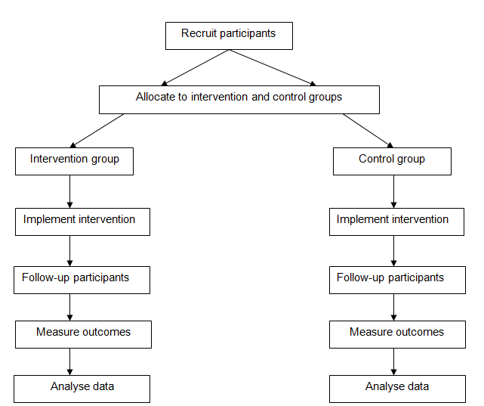
Pin the Bias on the RCT
Allocation bias
Attrition bias
Confounding
Integrity of intervention
Power calculation
Reliability of outcome tool
Selection bias
Validity of outcome tool
Exercise Pg 6 Workbook

Slide 14
Ben Goldacre Video
https://www.ted.com/talks/ben_goldacre_what_doctors_don_t_know_about_the_drugs_they_prescribe/transcript?language=en
https://www.youtube.com/watch?v=RKmxL8VYy0M

Slide 15
Models of Critical Appraisal
Scales
These generate a “score”. Those categorised as “good” studies may be assigned a pre-review threshold score, eg. 3/5. The Jadad scale is perhaps the most well-known.
Checklists
Checklists offer a logical and structured approach to assessing methodological quality. Perhaps the most commonly-used example of this tool is produced by the UK Critical Appraisal Skills Programme (CASP).
Guidance notes are given to define the exact meaning of each possible answer. Space is also provided to write comments, but the answers tend to be simply Yes, No or Unclear. These results are not aggregated, but the questions are all pre-set and are supposed to be answered.
Domains
These focus on very specific elements of study design and conduct that might adversely affect the internal validity of a study. These criteria can differ depending on the review question and topic. It does not seek to assign a “score” to a study, nor is it restricted to answering all items. Rather, the tools assign a risk of bias for each domain, such as randomisation, and consider what the study has reportedly done to minimise that bias.
The best-known and universally-used examples of this type of appraisal tool are the Cochrane risk of bias tool.

Slide 16
Scales
Jadad Score Calculation
Item | Score
Was the study described as randomised? | 0/1
Was the method used to generate sequence of randomisation described and appropriate? | 0/1
Was the study described as double blind? | 0/1
Was the method of double blinding described and appropriate? | 0/1
Was there a description of withdrawals and dropouts? | 0/1
Jadad AR, Moore RA, Carroll D, et al. Assessing the quality of reports of randomized clinical trials: is blinding necessary? Control Clin Trials 1996;17:1–12.

Slide 17
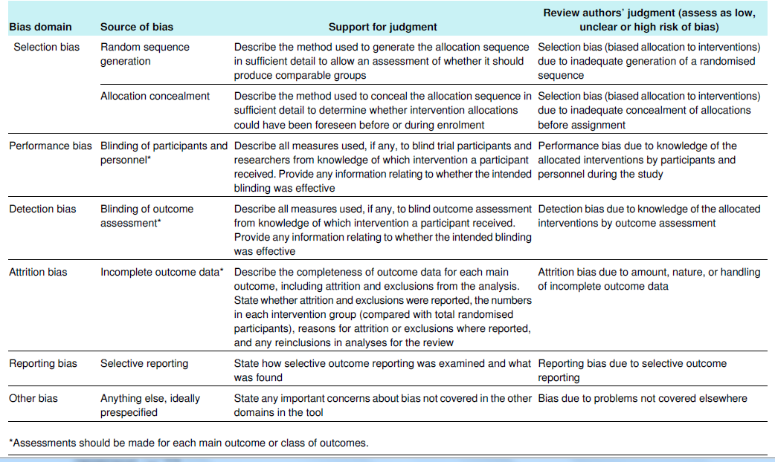
Domain based
18
BMJ 2011;343:d5928 doi: 10.1136/bmj.d5928

Slide 18
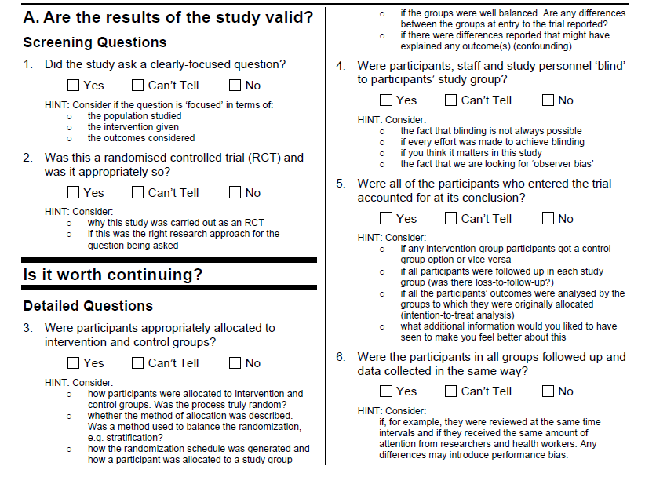
Checklists
Checklists
CASP RCT Checklist

Slide 19
Critically Appraising an Article
Use the CASP Checklist provided to critically appraise the article
What type of Study is it?
What Bias have you recognised?

Slide 20
Other Library Services
UptoDate
DynaMed
Anatomy.TV
Literature searching Service
Article and book requests
Current Awareness
Training in accessing online resources and critical appraisal
Library facilities – PCs with Internet access, printing, scanning and photocopying

Slide 21

Library outreach service
The library
Level 5, Education Centre
Upper Maudlin St
Tel. ext. 20105
Email. library@uhbristol.nhs.uk

